Slide 1
Digital Seer
October 2017

Slide 2
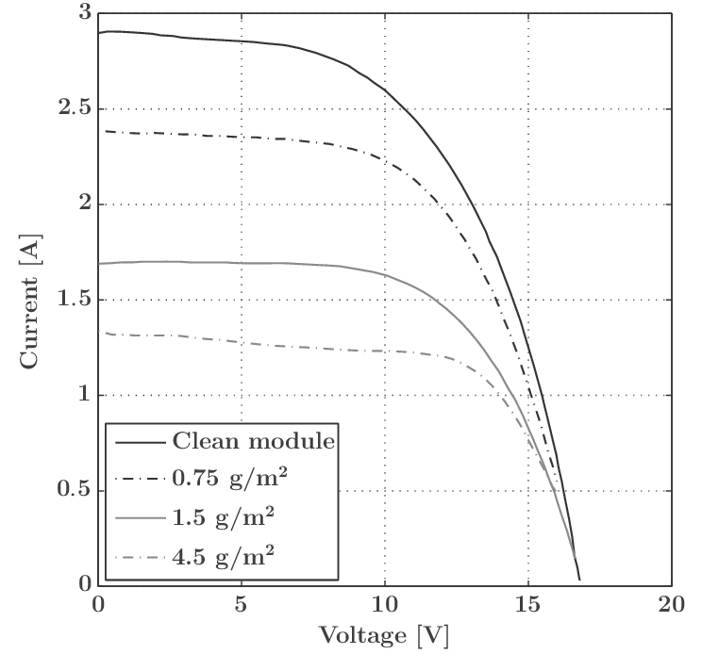
Solar Industry @ Glance
Energy distribution graph
Solar Panel Usage
Revenue ($Million)
Year
Remote plant monitoring
Forecasting weather
Periodic on-site inspection
Industry needs
Dust accumulation on panels cuts solar energy production by up to 25% ‒ IITGN & Duke university.
Fast response to system faults
Optimize maintenance
Identifying component failure
Notes:
Src : http://www.sciencedirect.com/science/article/pii/S0301421508004126

Slide 3
Capgemini Solution – Digital Seer
Locating
assets
on map
Asset Optimization
Digital Seer
Dashboards to monitor health of the asset
Maintaining incident history
Customised alert mechanism
Directed towards concerned personnel

Slide 4
Features and Benefits
Predicting the change
of Tilt Angle
Benefits
$
Scheduling Module
Cleaning
Reduce carbon footprint
Optimization of plant production for increased asset revenue
High Reliability and low maintenance
Reduction of risk for asset owners and investors
Transparency on plant production, performance and risks
Alerting when
decrease in yield
Digital Seer
10-40%
$
2-6%
Reduction in reactive maintenance
5-10%
5-25%
Increased yeild
Performance
Analytics
3-40%
Inventory
cost reduction
5-25%
99%
Incident Reduction
Reduction in IT Total cost Of Ownership
Gain in employee productivity
Increased
plant Availability
Locating Asset
Src : GE Power/ GE APM
Notes:
http://solarbyempire.com/commercial/business-benefits
https://www.ge.com/digital/sites/default/files/APM-asset-performance-management-from-ge-digital.pdf
https://www.gepowerconversion.com/inspire/unmanned-power-plant%E2%80%94-science-fiction-industrial-reality

Slide 5

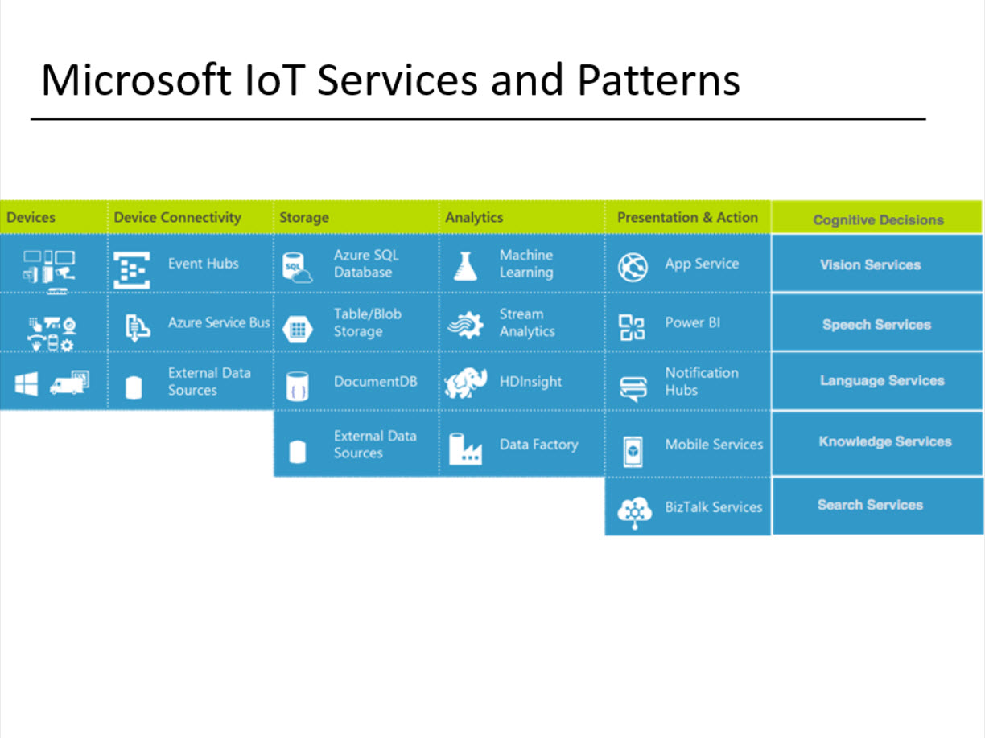
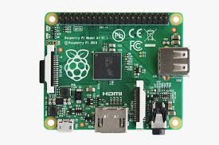
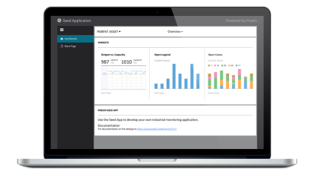
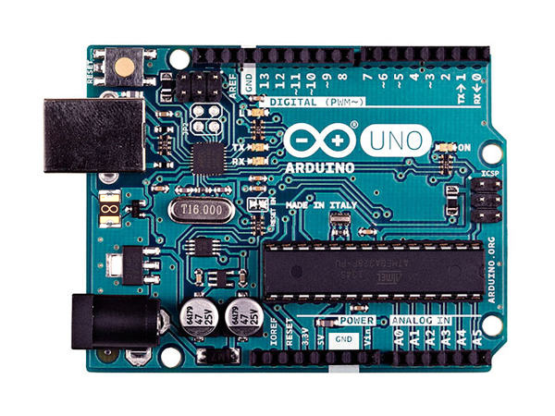
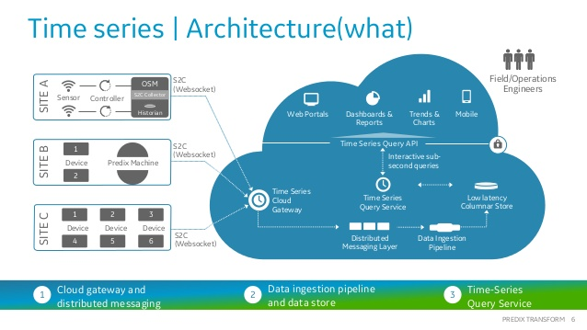
Technical Architecture @ Digital Industrial Lab
Data Acquisition
Data Communication
Data Storage
Data Processing & Analytics
Voltage
Current
Predix Machine
Solar - Module
PostgreSQL
Micro service
MQTT
Raspberry Pi
1
WiFi
Analytics
WIFI
model
Analytics
Predix Web application
Arduino UNO
GPS
Current
Voltage
GPS
Temperature
Time series
Wind Mill
Train

Slide 6
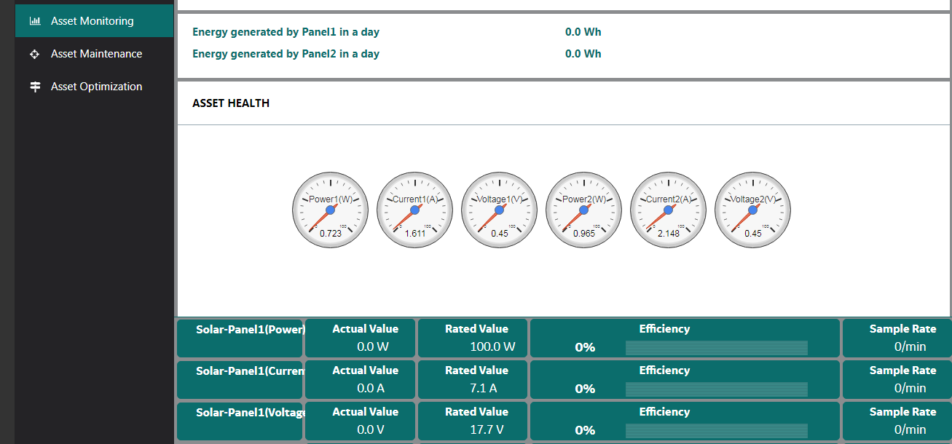
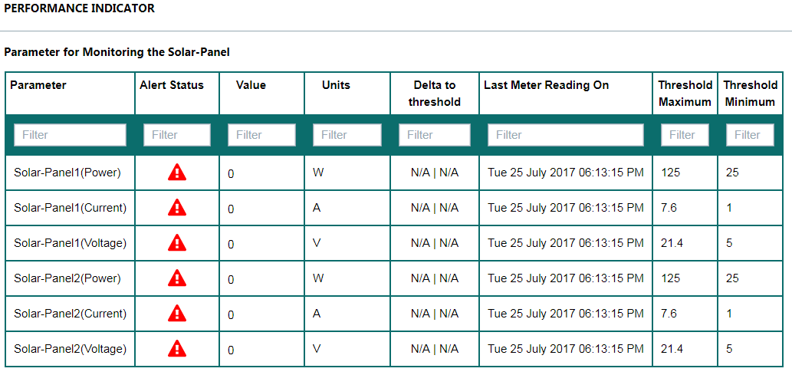
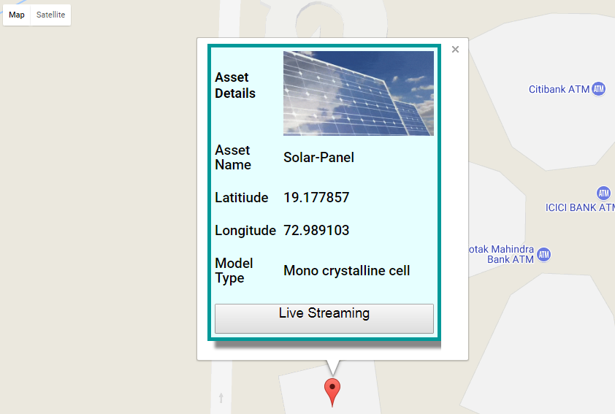
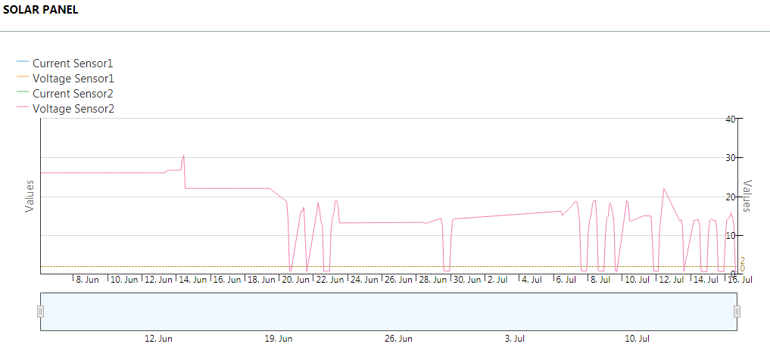
Digital Seer App
Launch DEMO

Slide 7
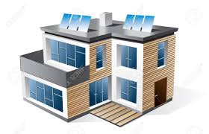
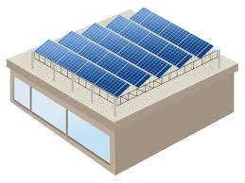
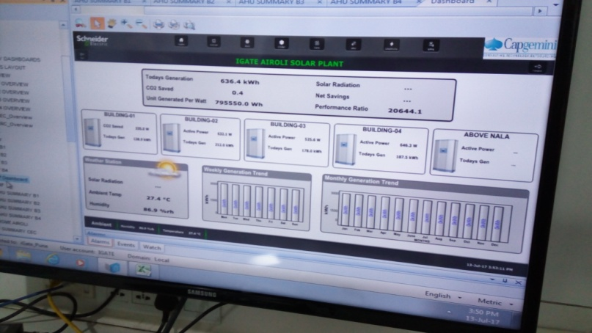
Solar Plant Structure @ Yosemite
Building 1
Building 2
Building 3
Building 4
External Road
No. of Modules : 260
No. of Modules : 360
No. of Modules : 313
No. of Modules : 230
No. of Modules : 400
DC Capacity (kWp) :83.20
DC Capacity (kWp) :83.20
DC Capacity (kWp) :83.20
DC Capacity (kWp) :83.20
DC Capacity (kWp) :83.20
Schneider Electric Dashboard

Slide 8

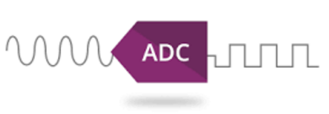

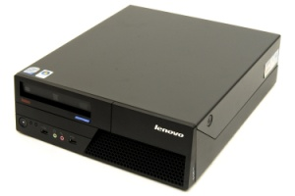
Technical Architecture For Yosemite Solar PV Plant
Data Acquisition
Data Communication
Data Storage
Data Processing & Analytics
Predix Machine
MQTT
PostgreSQL
Micro service
Raspberry Pi
1
Inverter
Inverter
WiFi
Analytics
WIFI
model
Analytics
Predix Web application
A2D Converter
Time series
Network Switch
XIOT Agent

Slide 9
Future Roadmap
Domain Scaling
More Scalable Solution to target multiple Industry
3
2
Technology
Scaling
App
Enhancement
< /…/ >
Expand asset coverage
Connected assets for effective decision making
Correlational analytics between asset types
1
User specific view
Asset optimization
Predictive analytics

